Slide 1


SMART INDIA HACKATHON 2024
Problem Statement ID – 1550
Problem Statement Title- Development of portable device (non-contact device) for measurement of eye pressure in glaucoma patients for usage at home.
Theme- MedTech/BioTech/HealthTech
PS Category- Hardware
Team ID-
Team Name (Registered on portal) - TechSmiths

Slide 2
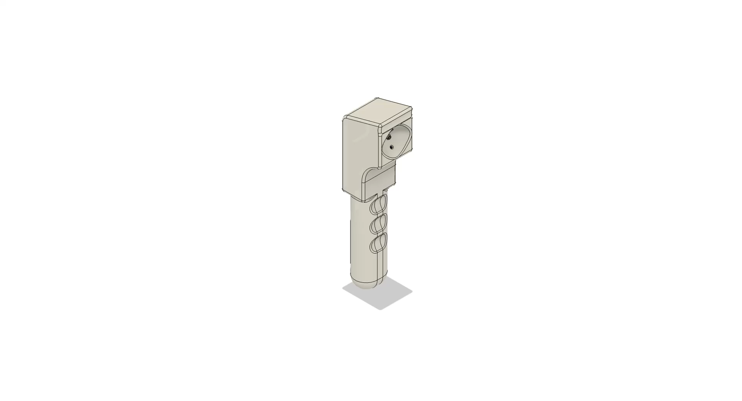
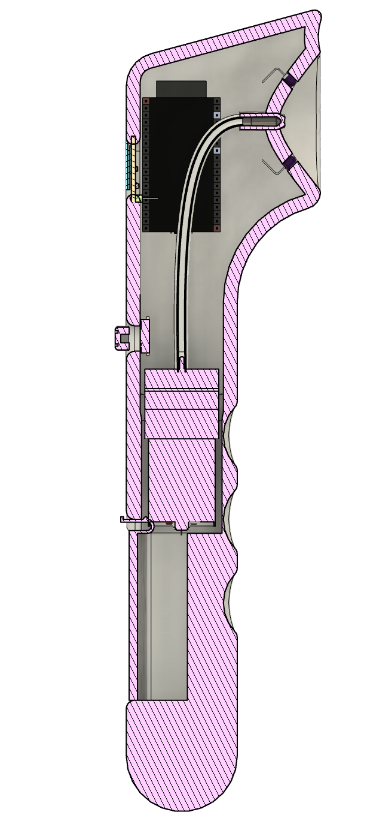
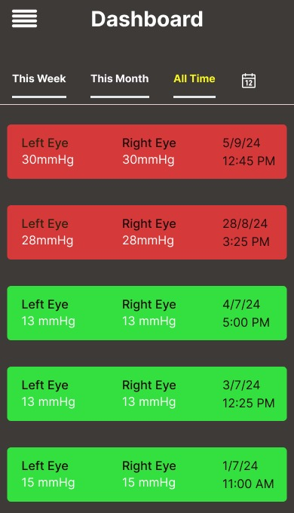
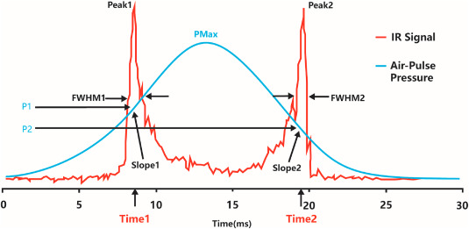
HANDHELD AIR PUFF TONOMETER
TechSmiths
Our device is a handheld air puff tonometer designed to measure intraocular pressure (IOP) for glaucoma screening and diagnosis. It utilizes an air pump to deliver a controlled puff of air to the cornea and infrared (IR) sensors to detect the corneal deformation in response to the puff. The microcontroller processes this data to calculate the IOP, which is displayed on a screen. The device also stores the measurement records in a cloud-based database for future reference. Compact and portable, it offers an easy-to-use interface for efficient and non-invasive eye pressure monitoring.

Slide 3
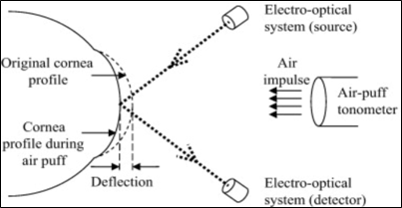
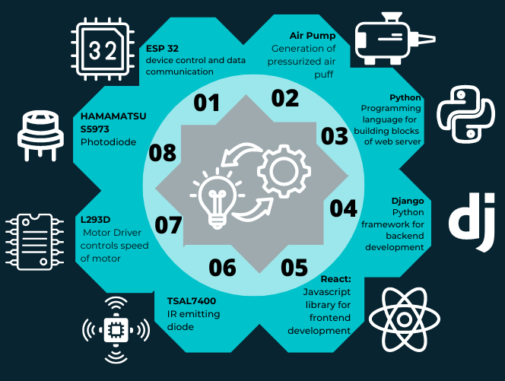
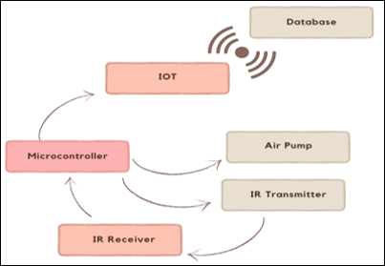
TECHNICAL APPROACH
TechSmiths

Slide 4
FEASIBILITY AND VIABILITY
TechSmiths
Business Potential
USE CASES
Our solution offers non-contact intraocular pressure measurement, significantly reducing the risk of bacterial infection by 90-95% compared to traditional at-home tonometers, which require corneal contact and sterilization.
This non-invasive approach simplifies eye pressure monitoring, aiding in the early detection of glaucoma.
The device features a self-alignment mechanism, utilizing forehead and cheekbone references for accurate positioning.
It is compact, self-powered, and designed for portability, making it ideal for travel.
The system maintains a comprehensive database of previous readings, allowing for trend analysis and more precise detection of glaucoma onset.
DATA ANALYTICS AND INSIGHTS
We provide advanced data analytics services, offering comprehensive reports and actionable insights based on intraocular pressure patterns.
Through continuous monitoring and data collection, our solution allows for early detection of glaucoma trends, enabling timely interventions and more effective treatment plans.
IMPROVED DISEASE MONITORING
SELF An average human is 6-9% prone to glaucoma especially in the age group of 60 above. Our solution enables patients to monitor their intraocular pressure regularly from home, reducing the need for frequent visits to an ophthalmologist.
FIELD VISITS Underprivileged areas lack access to costly regular tonometers priced around Rs. 2 lakhs, while our solution at Rs. 5000, offers a 97% price reduction. This makes glaucoma screenings more accessible in government hospitals and underserved communities.

Slide 5
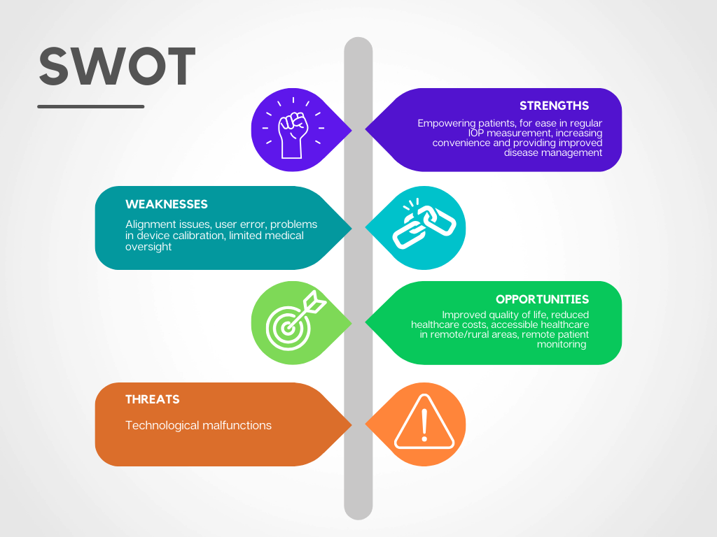
IMPACT AND BENEFITS
TechSmiths

Slide 6
RESEARCH AND REFERENCES
TechSmiths
https://www.sciencedirect.com/topics/nursing-and-health-professions/non-contact-tonometer
https://www.researchgate.net/publication/320422033_Comparison_of_Goldmann_Applanation_Diaton_Transpalpebral_and_Air_Puff_Tonometers
https://www.researchgate.net/publication/343953106_Developments_and_Progress_in_Non-contact_Eye_Tonometer_Calibration
https://www.sciencedirect.com/science/article/abs/pii/S0924424722003466
https://www.mdpi.com/2673-4591/59/1/179
https://www.ncbi.nlm.nih.gov/pmc/articles/PMC3939731/
https://journals.plos.org/plosone/article?id=10.1371/journal.pone.0186738
https://www.prnewswire.com/il/news-releases/ophthalmic-sciences-unveils-worlds-first-ai-contactless-device-for-measuring-eye-fluid-pressure-301438718.html
https://youtu.be/_qcHFPXqICs?si=OVkRaiPvYGLLdgJO
https://www.ncbi.nlm.nih.gov/pmc/articles/PMC5159455/
https://www.icare-world.com/us/product/icare-ic100-tonometer/

